Slide 1
EXPERT SYSTEM FOR VISUALLY CHALLENGED USING AI and ML
Project Proposal Presentation
by
Adarsh verma(2147102), Amber Ujjwal Linda(2147104), Ankur Sharma(217105)
Project Guide
Dr. THIRUNAVUKKARASU V
Department of Computer Science
CHRIST(Deemed to be University), Bengaluru-29

Slide 2
AGENDA
Existing System
Limitations of Existing System
Proposed System
Functional Description
Solution Architecture
Software & Hardware Requirements
Benefits of Proposed System
Plan of Work
References

Slide 3
1. Introduction
Application for Visually Challenged users.
Three functionalities
Text to speech, Teacher detector, campus tour
This application is built for the users who are in Christ University.

Slide 4
2. Existing System
There are already many applications which are made for the visually challenged people namely: Be my eyes, Seeing Ai, Aira, Lookout.
These applications use the concept of artificial intelligence and machine learning.
they have the functionality of recognising a person, reading text out loud, guides whether the content in the camera is visible or not, detects the currency, using a barcode scanner it identifies and says out loud the description of the product, scene description.
These use the concept of computer vision, image recognition, image processing, natural language processing, sentiment analysis.

Slide 5
3. Limitations of Existing system
The existing system does not have a better model.
Application is very general, it does not have data specific to a organization.

Slide 6
4. Proposed System
This application is going to be a android application.
As the application is going to be only for the visually impaired students the first or the landing page will have three modules.
The first module is going to be the campus tour which will guide the students and will let them know about the place they are visiting.
The second functionality is going to be Teacher recognition using which the student can identify the teacher.
The third functionality is going to be the document reader using which the students can read the printed document.

Slide 7
5. Functional Description
The application is going to be a android application which will be installed on a mobile device. After downloading the application the user have to give few permissions such as accessing the camera and the mic.
The application will use the camera to scan the object in front of it and it’s going to give the response based on the data it was trained.
The camera used for this application is going to be the back camera, as most of the module will be using the back camera.
CNN, yolov5,COCO128, Tesseract OCR, AWS Rekognition.
Using the back camera the device will recognize the person, using the model on which it was trained.

Slide 8
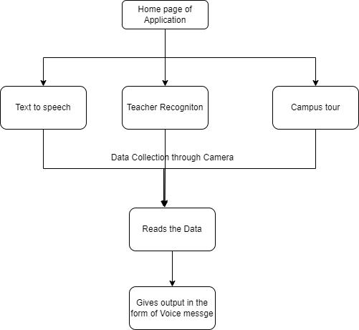
6. Solution Architecture

Slide 9
7. Software and Hardware Requirements
Software
Android 11 and above as the software inside smartphone or tablet.
Hardware
Smartphone with a good camera quality.

Slide 10
8. Benefits of Proposed System
Using the proposed system the user can explore the campus of Christ university.
Using the functionality of Text to speech the user can understand the content of any document.
Using the functionality of teacher recognition the user can get information about the teacher.

Slide 11
9. Plan of Work
Data should be collected in the form of images.
The data of images should be collected for Teacher recognition and campus tour.
A model should be trained based on the data.
The mobile application should be built with 3 functions.

Slide 12
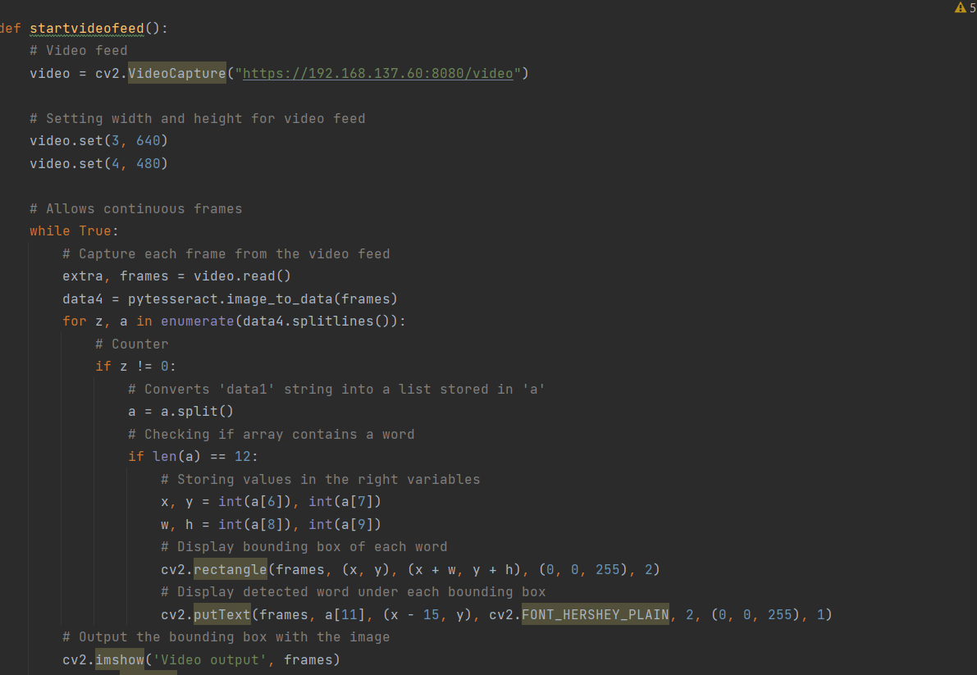
10. Demo Module1

Slide 13
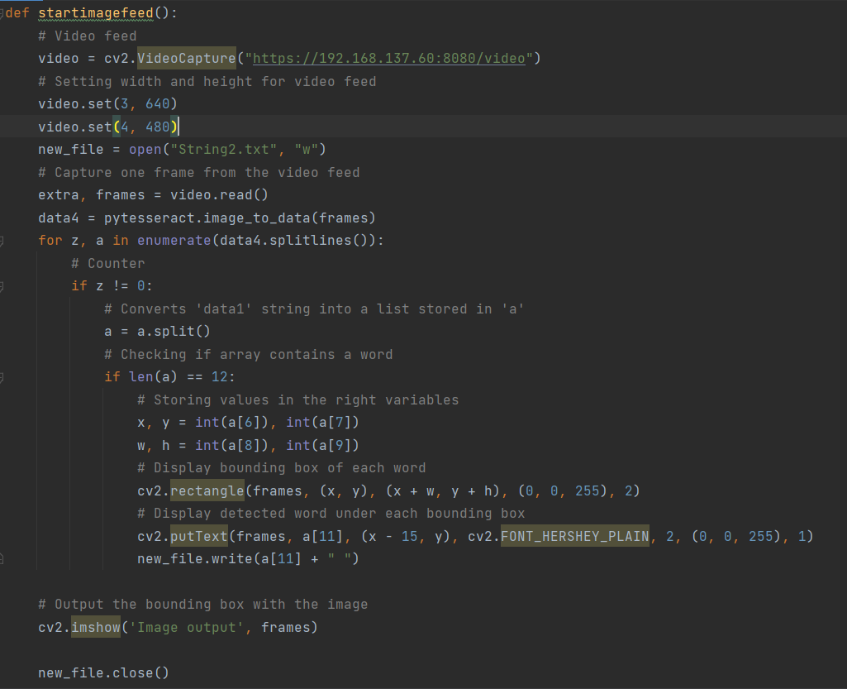
10. Demo Module1

Slide 14
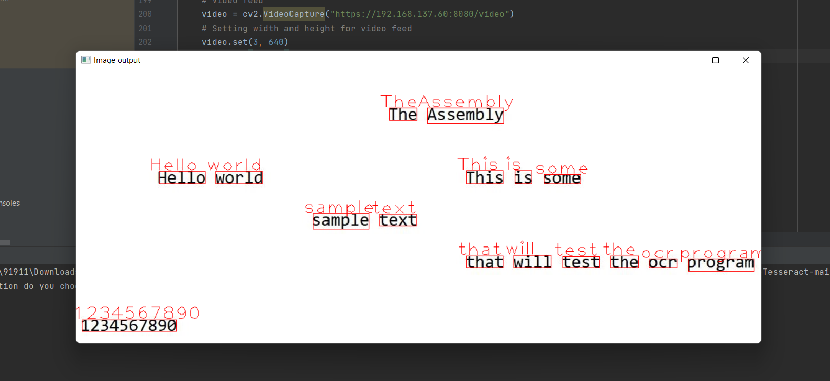
10. Demo Module1

Slide 15
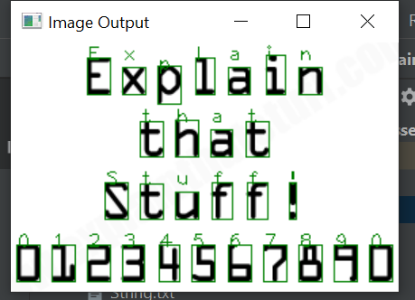
10. Demo Module1

Slide 16
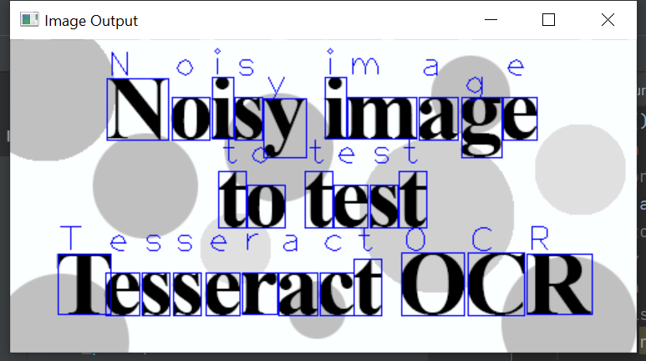
10. Demo Module1

Slide 17

10. Demo Module1
Output as Speech

Slide 18
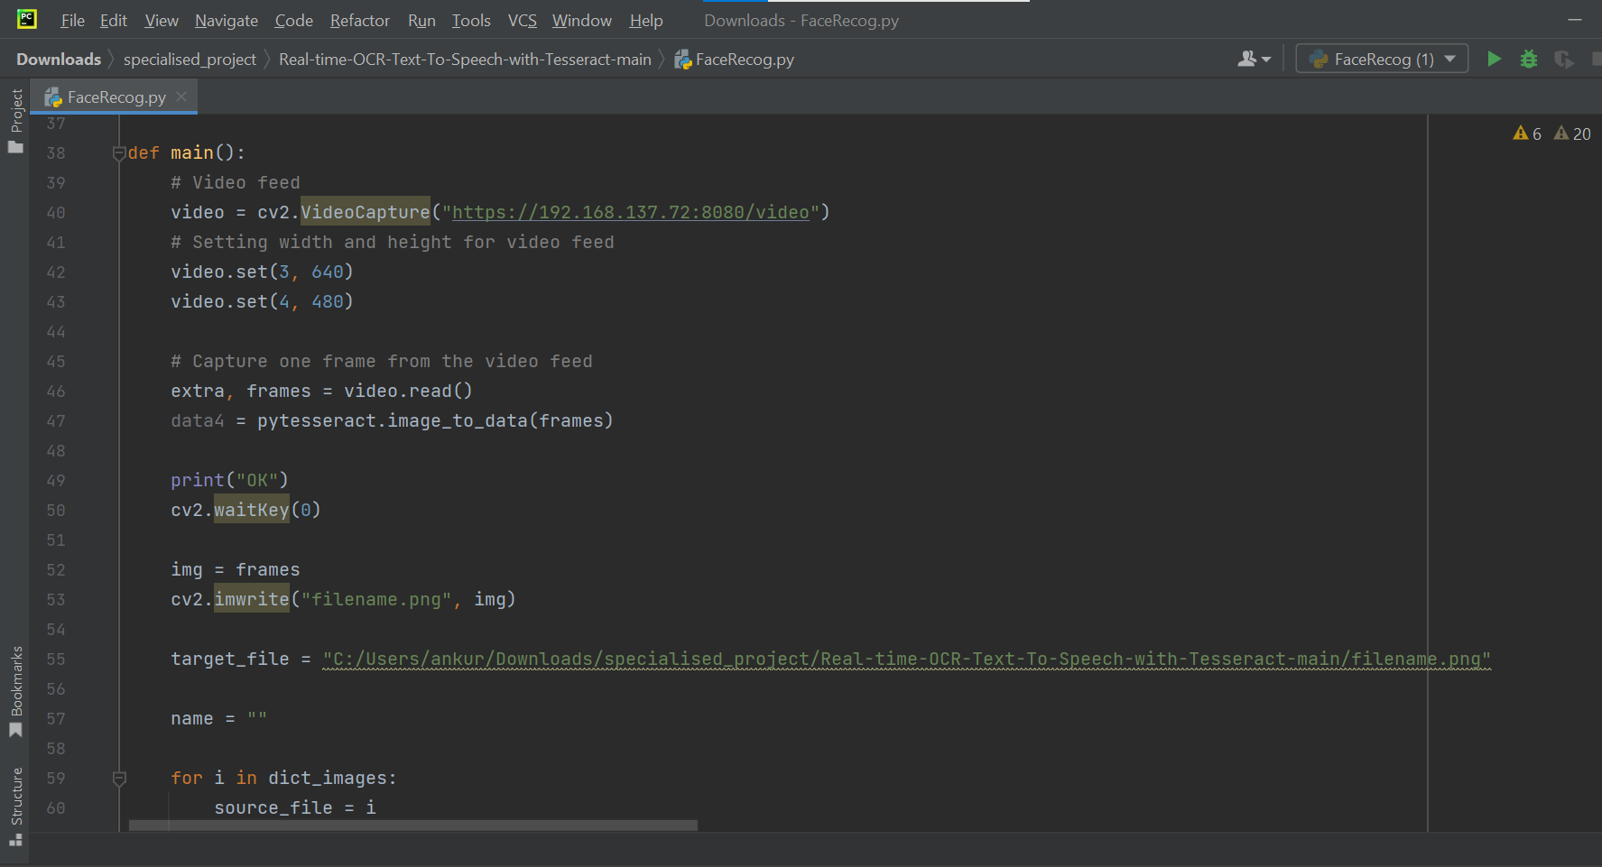
11. Demo Module2

Slide 19
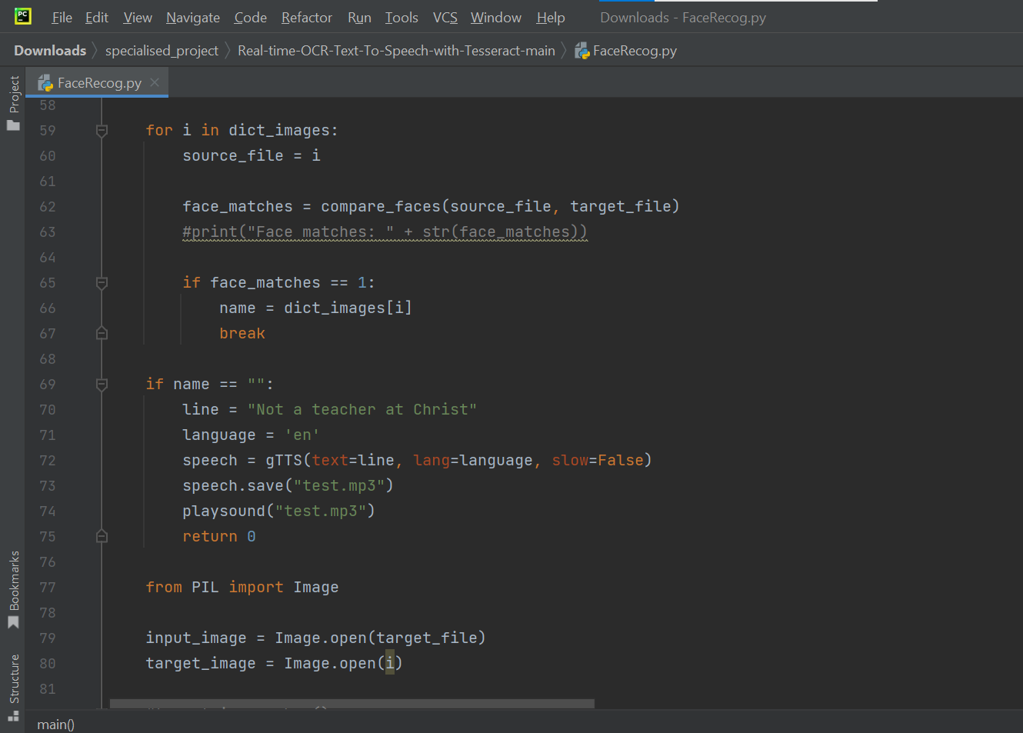
11. Demo Module2

Slide 20
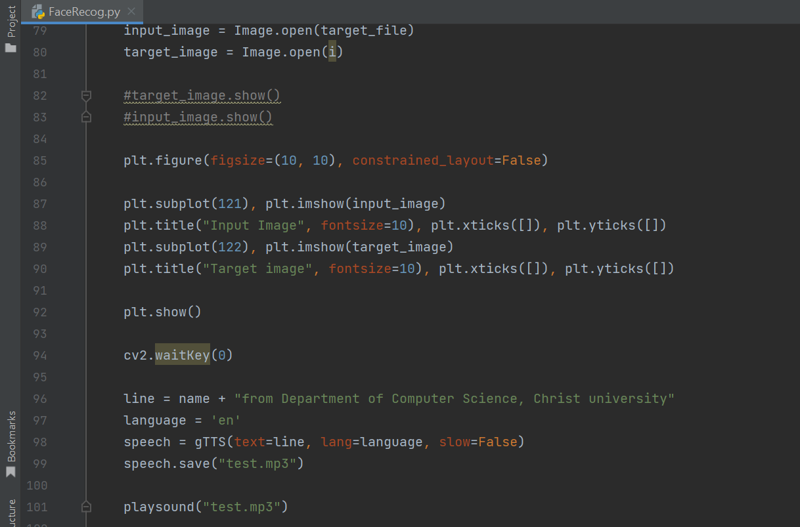
11. Demo Module2

Slide 21
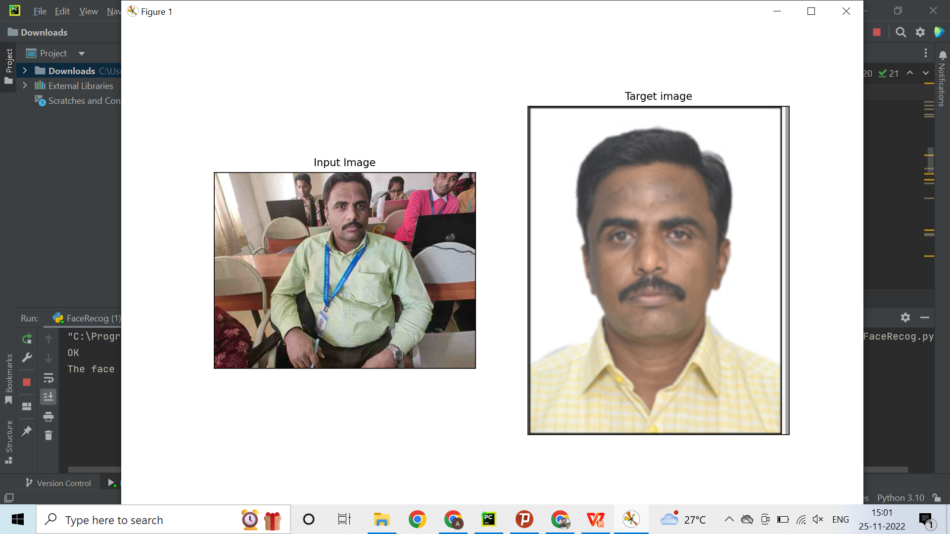
11. Demo Module2

Slide 22
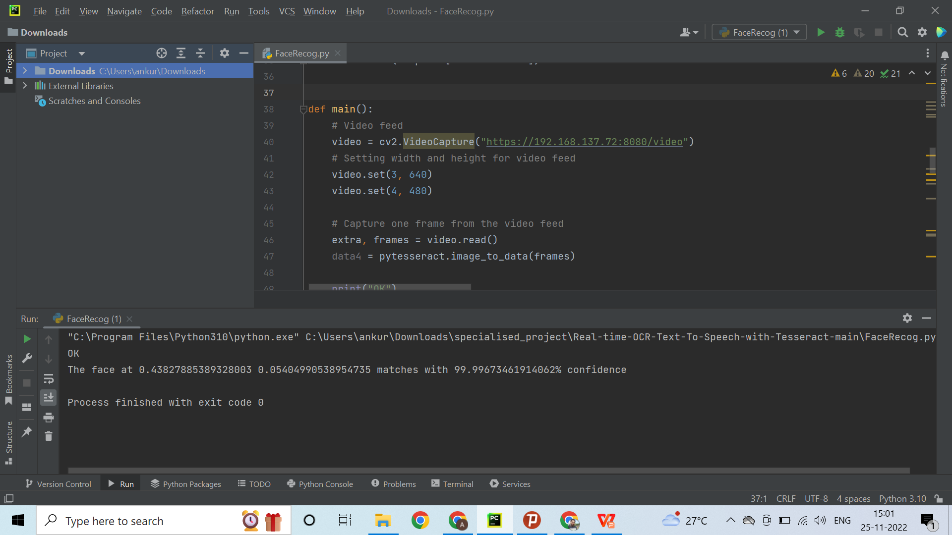
11. Demo Module2

Slide 23
11. Demo Module2

Slide 24
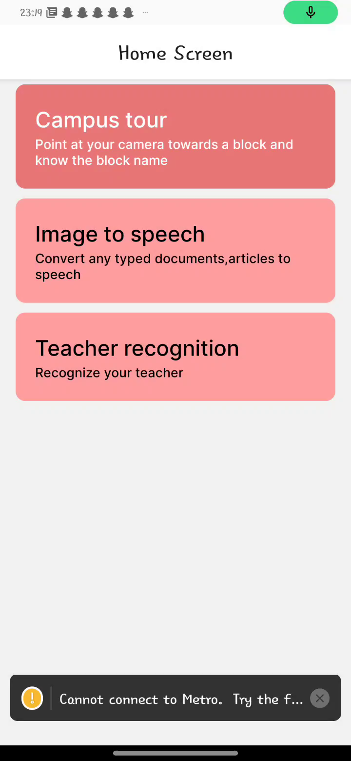
12 - UI Design Demo Video

Slide 25
13 - Steps to navigate through the APP
Step 1 - Open the app using Mobile’s Personal Assistance. (Example: Ask Google/Siri to open Sharigan App)
Step 2 - Use the volume buttons to navigate through the app modules.
i) Use volume down button to change module(Module name will be spoken out)
ii) Use volume up button to enter the module(Camera will be opened)
Step 3 - A voice instructing you the procees to proceed will be heard. Follow it.
(Example: If you enter “Teacher Recognition” module, it will say “Align your camera to the text and double click to capture the image”)
Step 4 - Double click to capture image and wait for the output as per the module selected(as audio).

Slide 26
10. References
Seeing AI https://www.microsoft.com/en-us/ai/seeing-ai
Be my eyes https://www.microsoft.com/en-us/ai/seeing-ai
Look out https://blog.google/outreach-initiatives/accessibility/lookout-app-help-blind-and-visually-impaired-people-learn-about-their-surroundings/
Aira https://aira.io/
Kaur, Parminder & Ganore, Mayuri & Doiphode, Rucha & Garud, Ashwini & Ghuge, Tejaswini. (2017). Be My Eyes : Android App for visually impaired people. 10.13140/RG.2.2.12307.48164.

